Slide 1
Data visualization with R
Tuan Thanh - 05/04/2025

Slide 2

Introduction
Why we need R to calculate and visualize data
Excel is a great program for visualizing and manipulating small data sets:
User-friendly interface.
Quickly entering, filtering, and sorting small datasets.
Don’t need to know programming.
→ Be not great for working with “big data”, resulting plots are generally not publishable.
Excel data analysis
Learning R and associated plotting packages is a great way to generate publishable figures in a reproducible fashion.

Slide 3
Introduction
Why we need R to calculate and visualize data
Keep you from accidentally editing your data.
Allow you to generate scripts that can be viewed later or reused to generate the same plot using different data.
→ Keep you from having to rely on your memory when wondering what data was used or how a plot was generated.

Slide 4
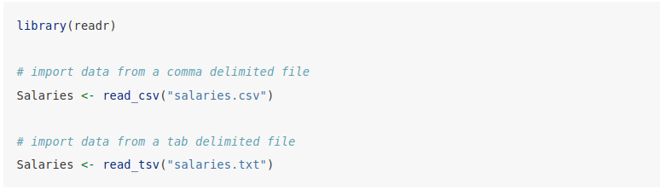
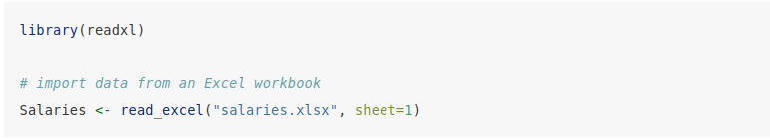
2. Import Data into R
Import data from format files: .csv, .tsv, .txt, .xlsx

Slide 5
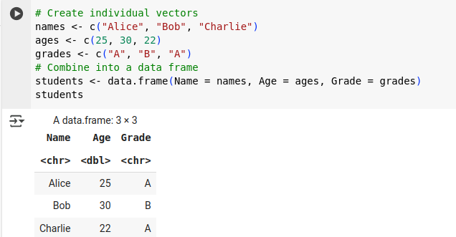
2. Import Data into R
Create data by vector and data.frame

Slide 6
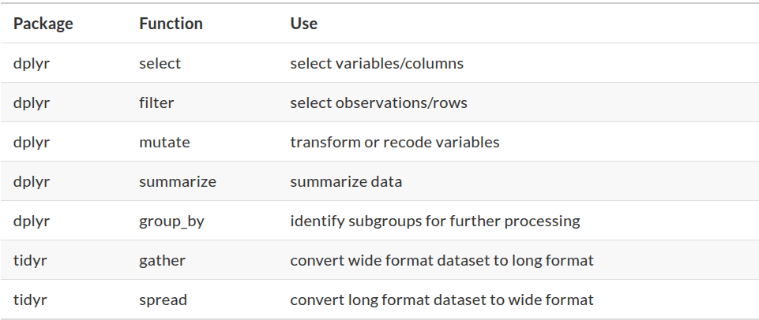
3. Cleaning data
Using the dplyr and tidyr packages are some of the quickest and easiest to learn

Slide 7
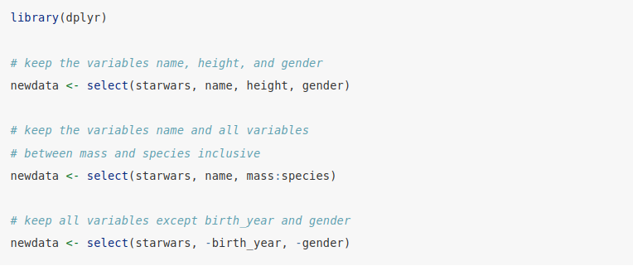
3. Cleaning data
Selecting variables

Slide 8
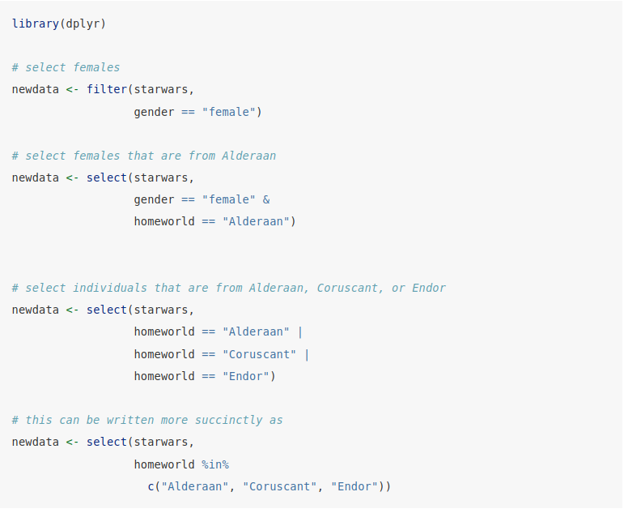
3. Cleaning data
Selecting observations

Slide 9
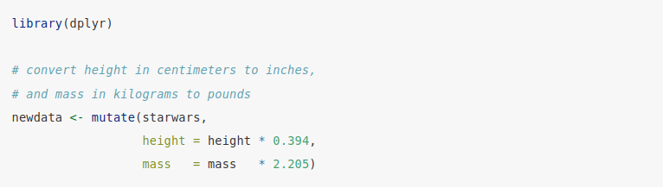
3. Cleaning data
Creating/Recoding variables

Slide 10
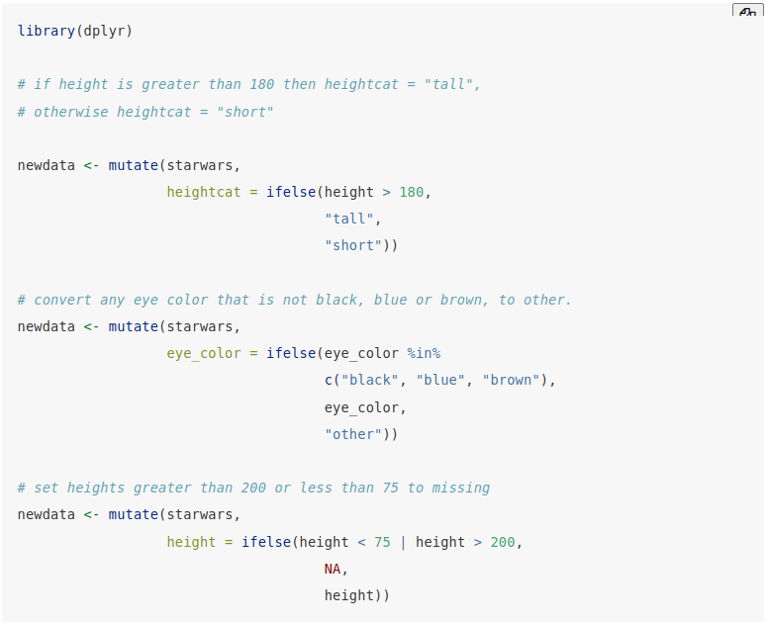
3. Cleaning data
Creating/Recoding variables

Slide 11
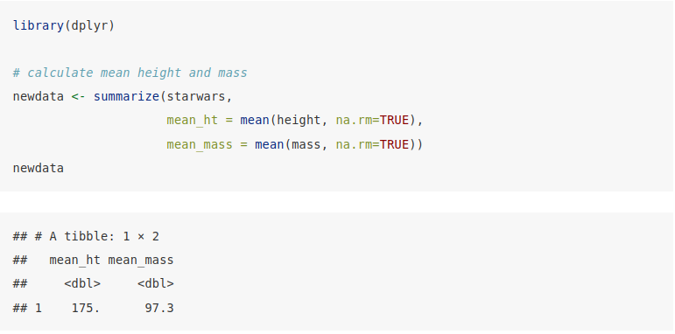
3. Cleaning data
Summarizing data

Slide 12
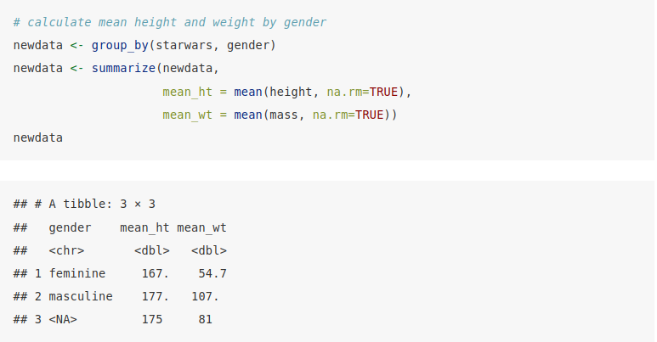
3. Cleaning data
Summarizing data

Slide 13
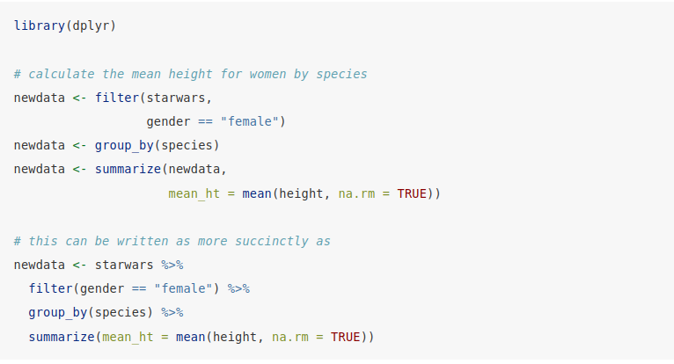
3. Cleaning data
Using pipes

Slide 14
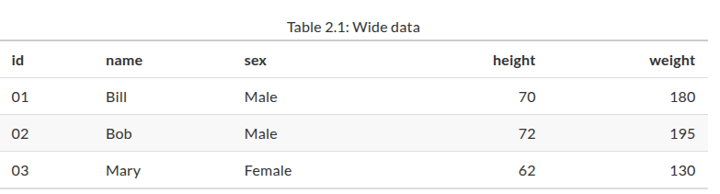
3. Cleaning data
Reshaping data

Slide 15
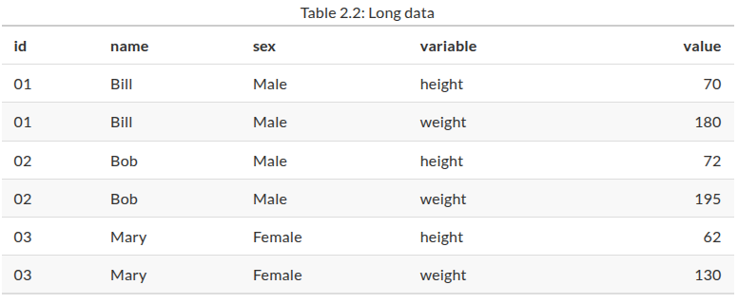
3. Cleaning data
Reshaping data

Slide 16
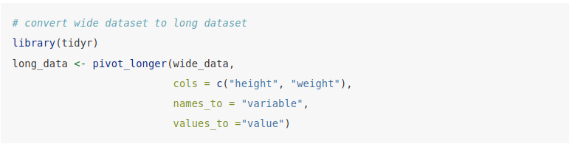
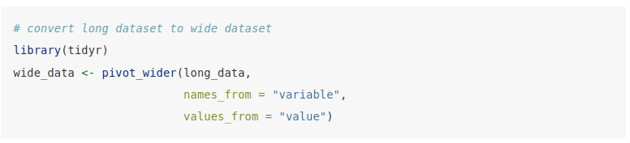
3. Cleaning data
Reshaping data

Slide 17
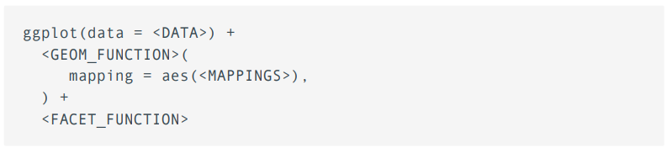
4. Visualization

Slide 18
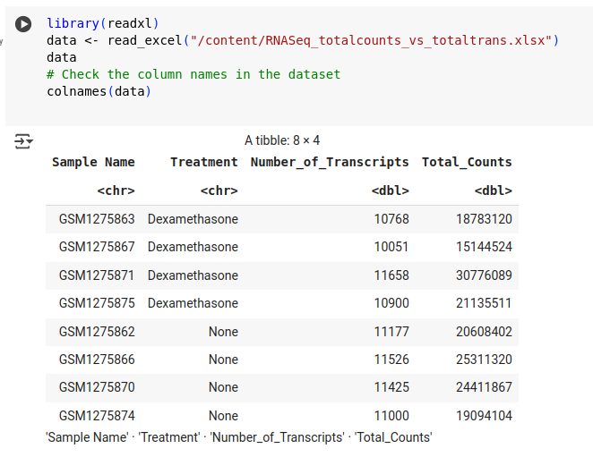
4. Visualization

Slide 19
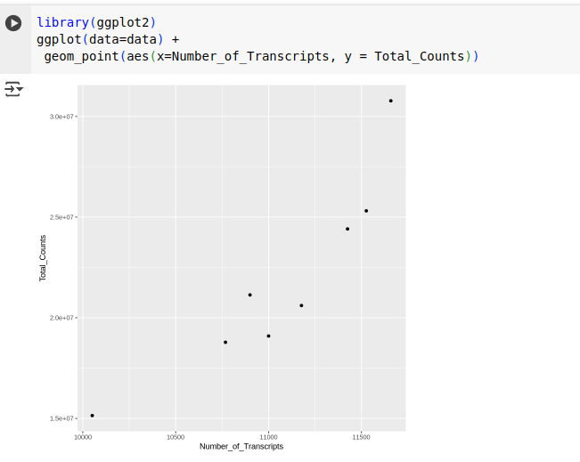
4. Visualization

Slide 20
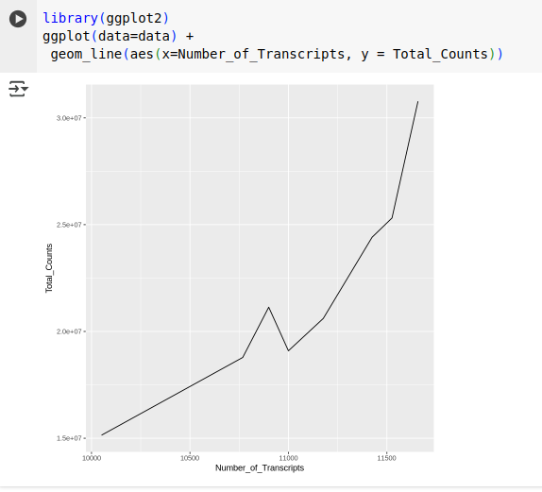
4. Visualization

Slide 21
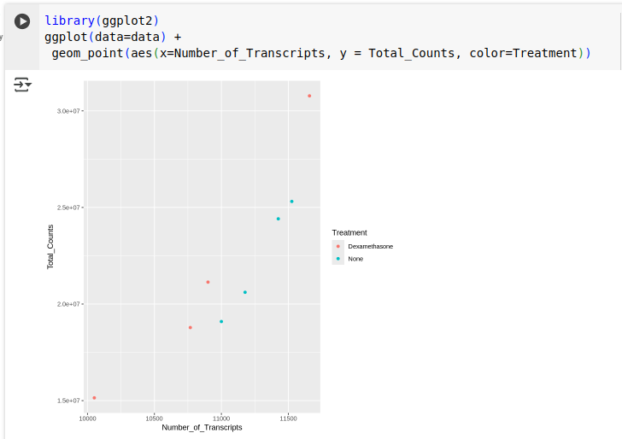
4. Visualization

Slide 22
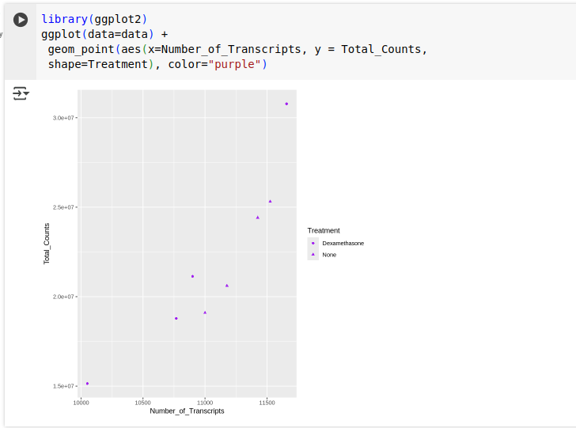
4. Visualization

Slide 23
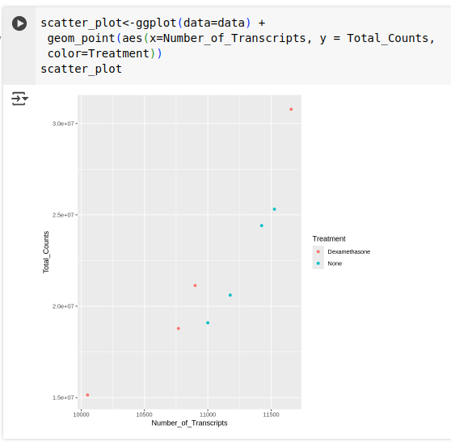
4. Visualization
store figures

Slide 24
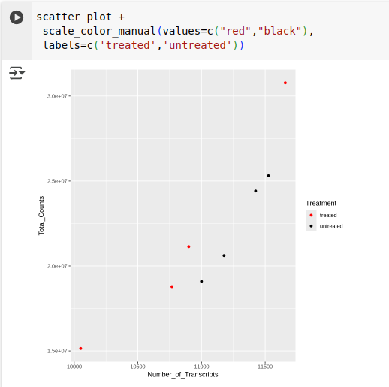
4. Visualization
store figures

Slide 25
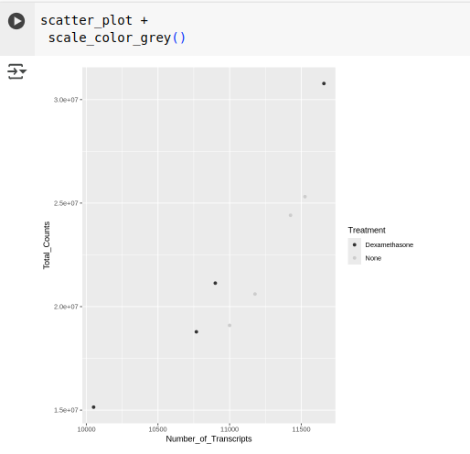
4. Visualization
store figures

Slide 26
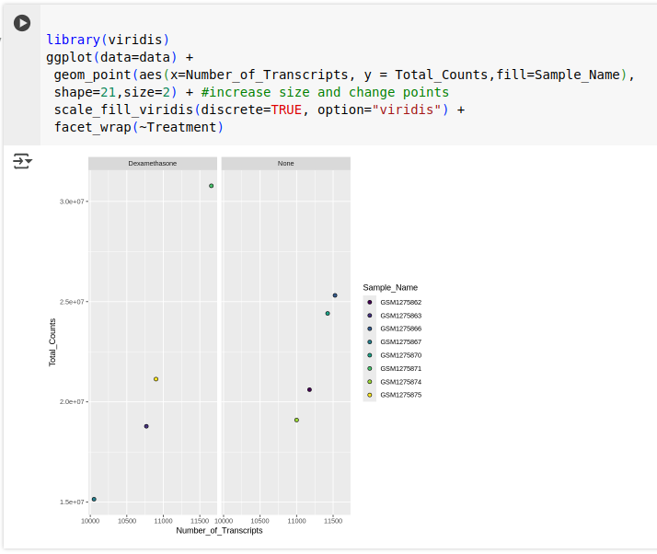
4. Visualization

Slide 27
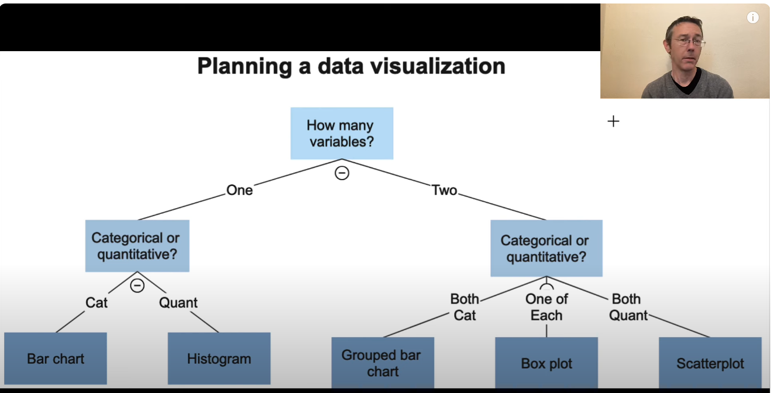
https://www.youtube.com/watch?v=McL9MMwmIZY

Slide 28
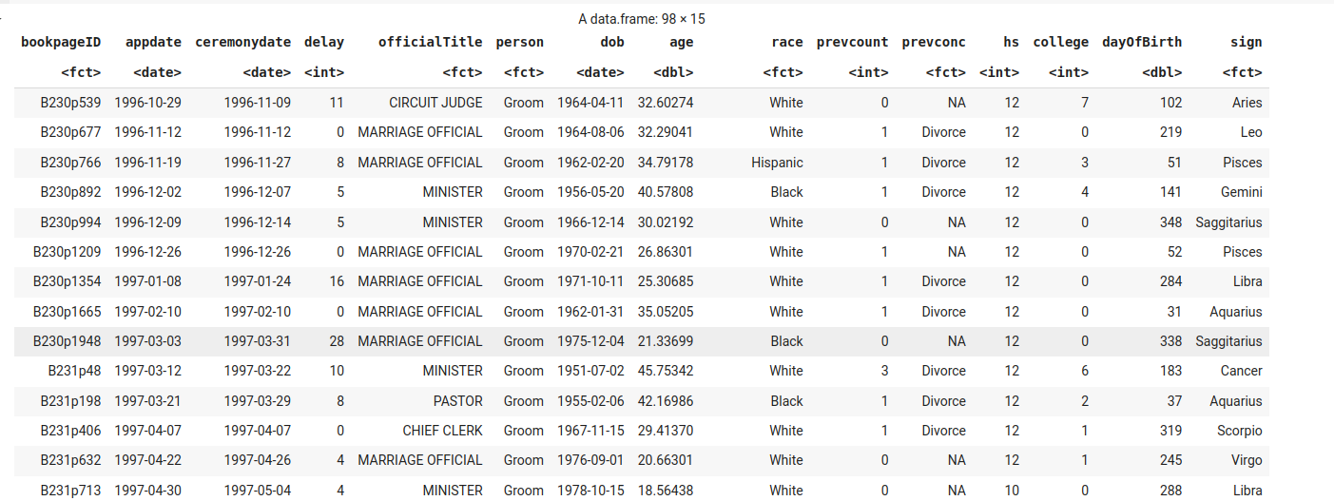
Univariate Graphs
Bar chart

Slide 29
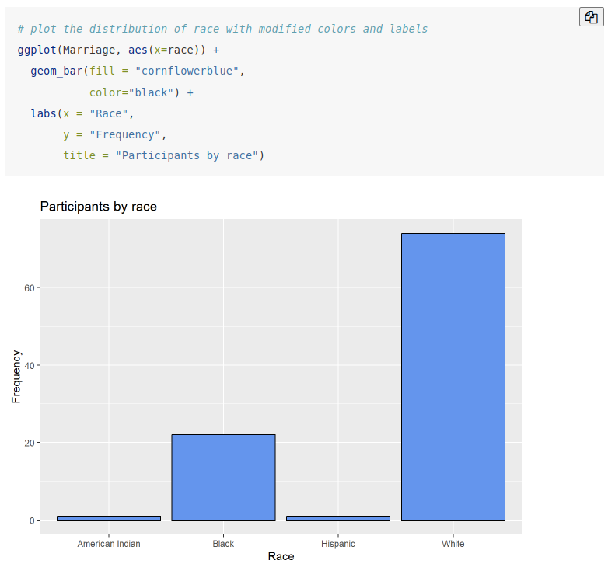
Univariate Graphs
Bar chart

Slide 30
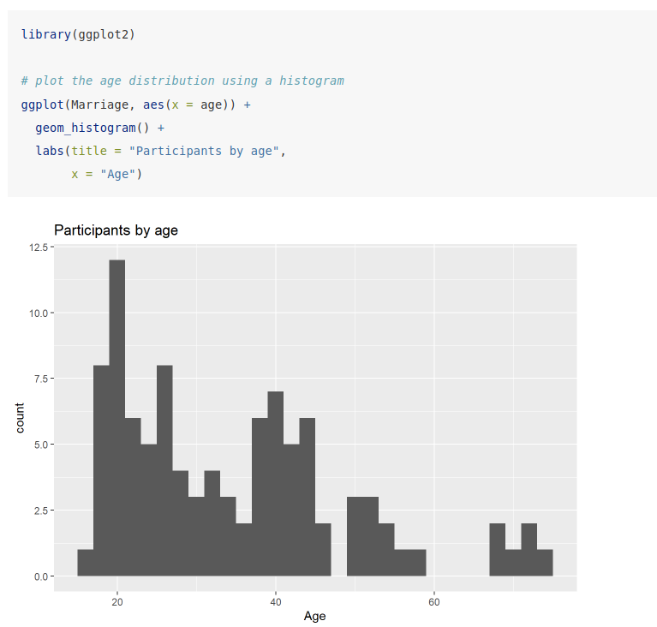
Univariate Graphs
Histogram

Slide 31
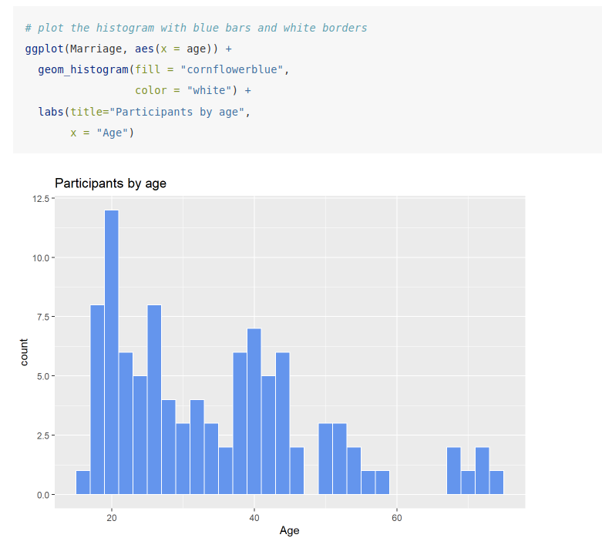
Univariate Graphs
Histogram

Slide 32
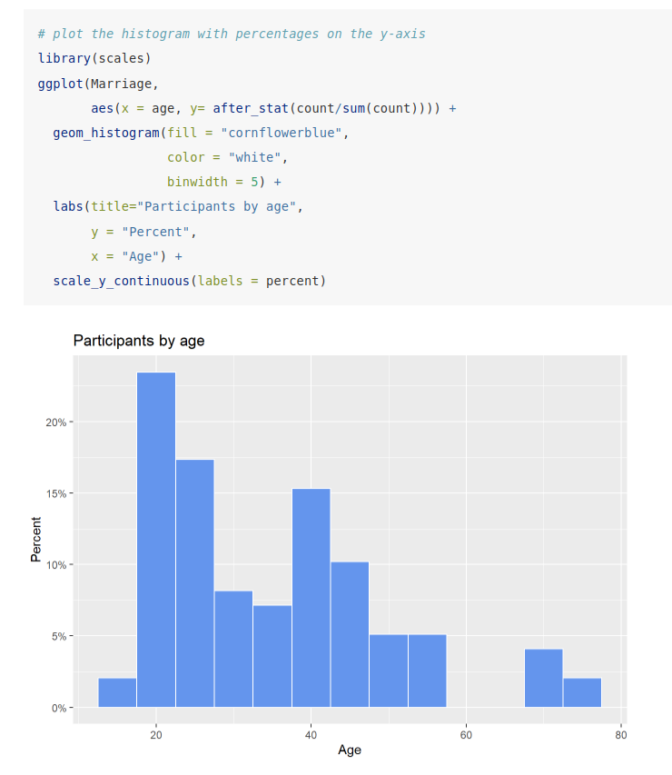
Univariate Graphs
Histogram

Slide 33
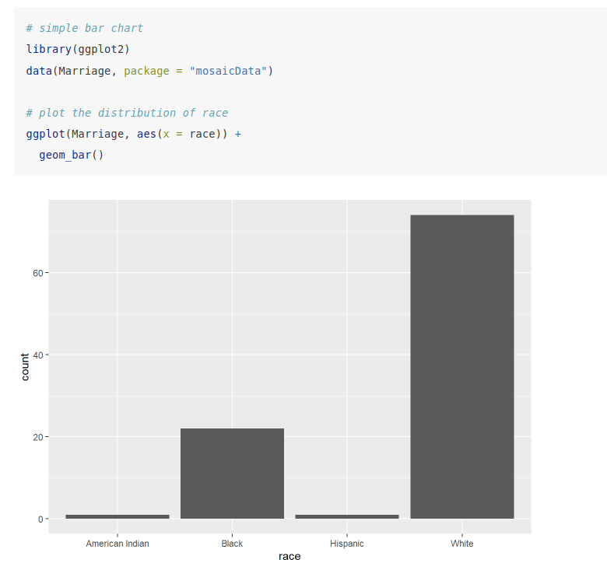
Univariate Graphs
Bar chart

Slide 34
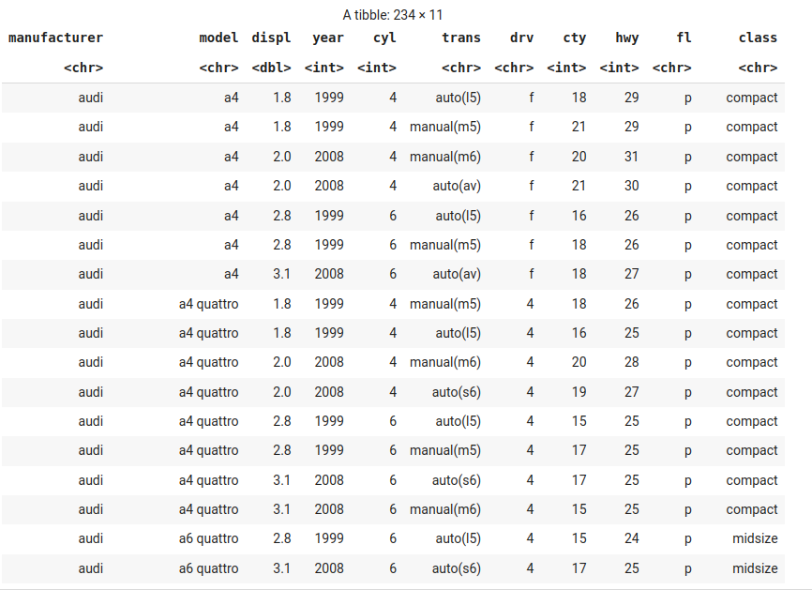
Bivariate Graphs

Slide 35
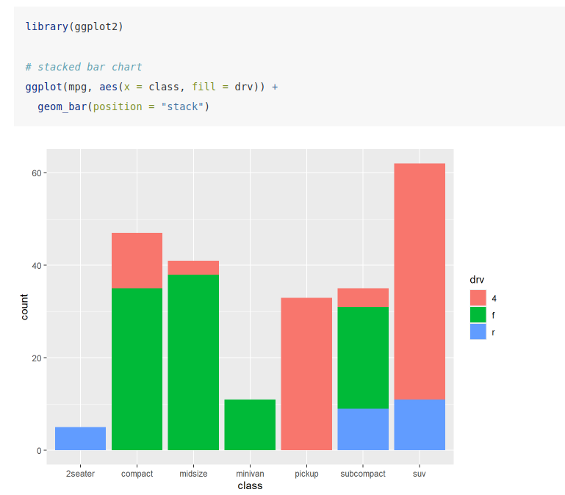
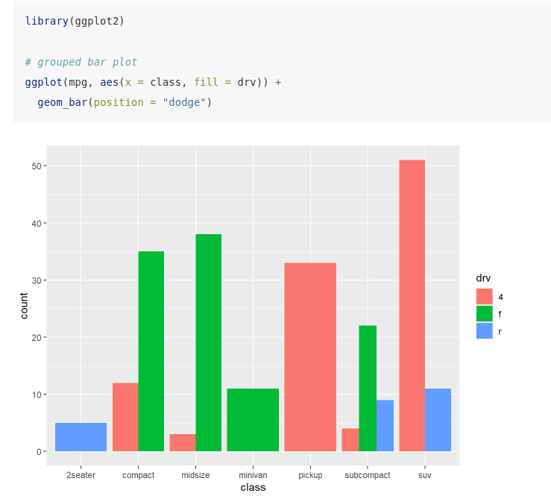
Bivariate Graphs
Categorical vs. Categorical

Slide 36
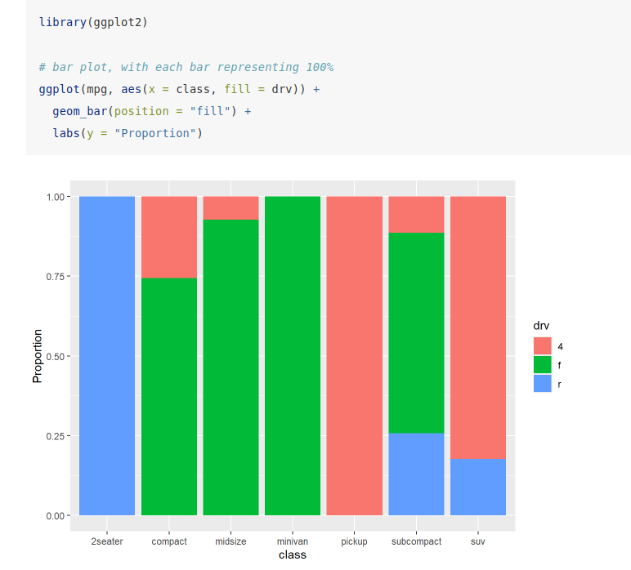
Bivariate Graphs
Categorical vs. Categorical

Slide 37
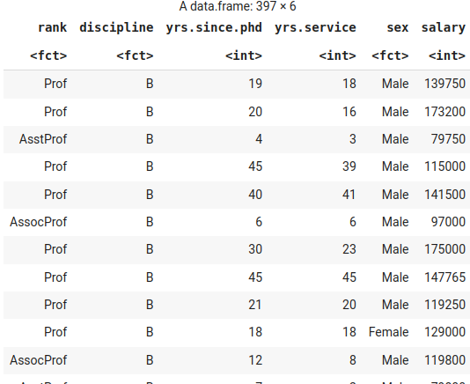
Bivariate Graphs
Quantitative vs. Quantitative

Slide 38
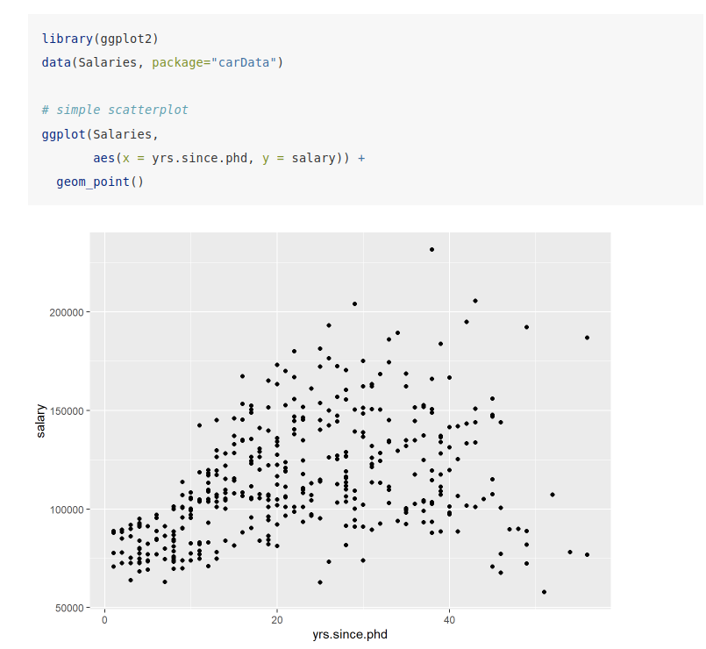
Bivariate Graphs
Quantitative vs. Quantitative

Slide 39
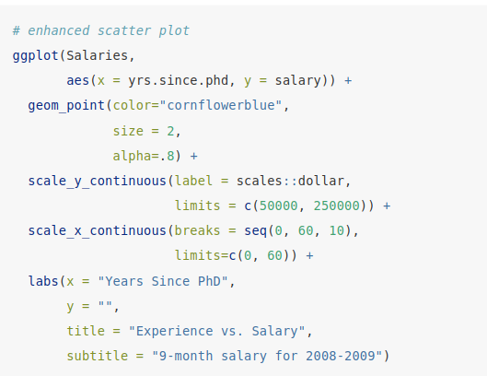
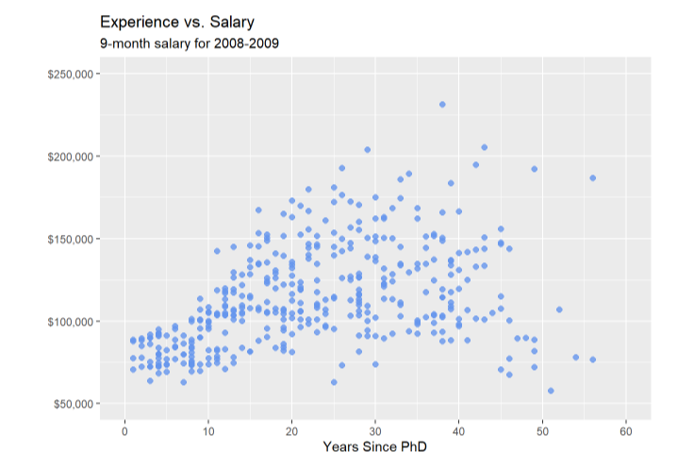
Bivariate Graphs
Quantitative vs. Quantitative

Slide 40
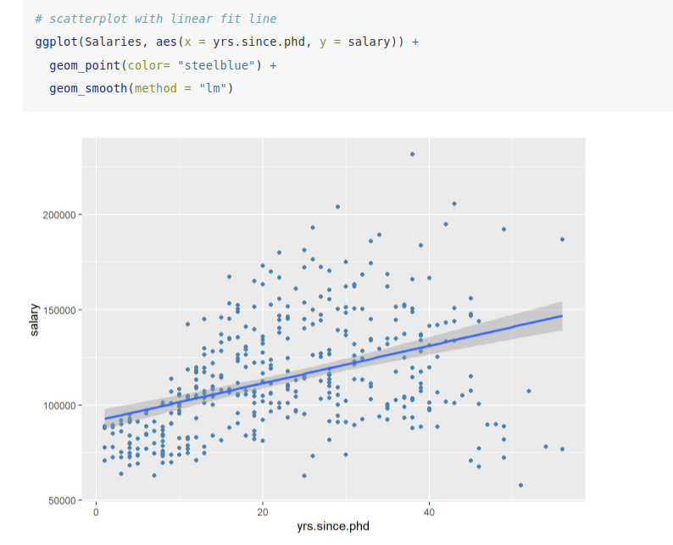
Bivariate Graphs
Quantitative vs. Quantitative

Slide 41
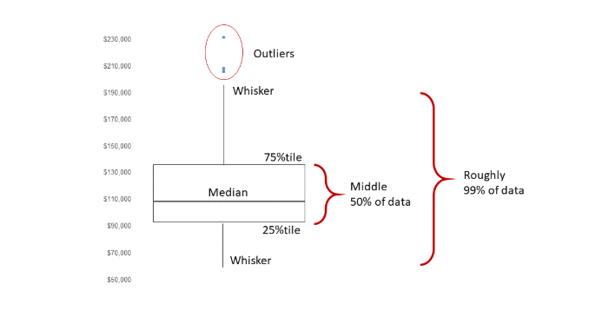
Bivariate Graphs
Categorical vs. Quantitative
Boxplot

Slide 42
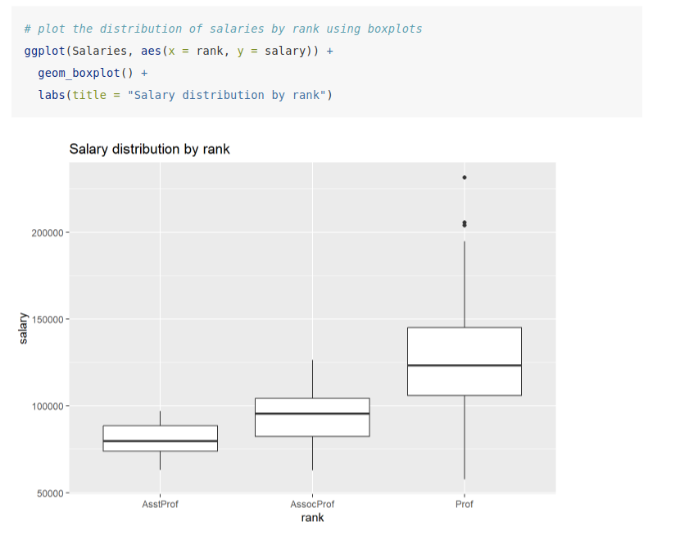
Bivariate Graphs
Categorical vs. Quantitative

Slide 43
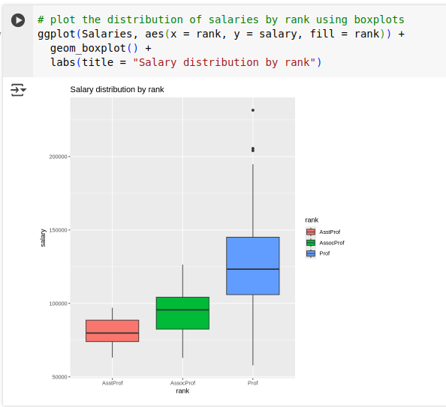
Bivariate Graphs
Categorical vs. Quantitative

Slide 44
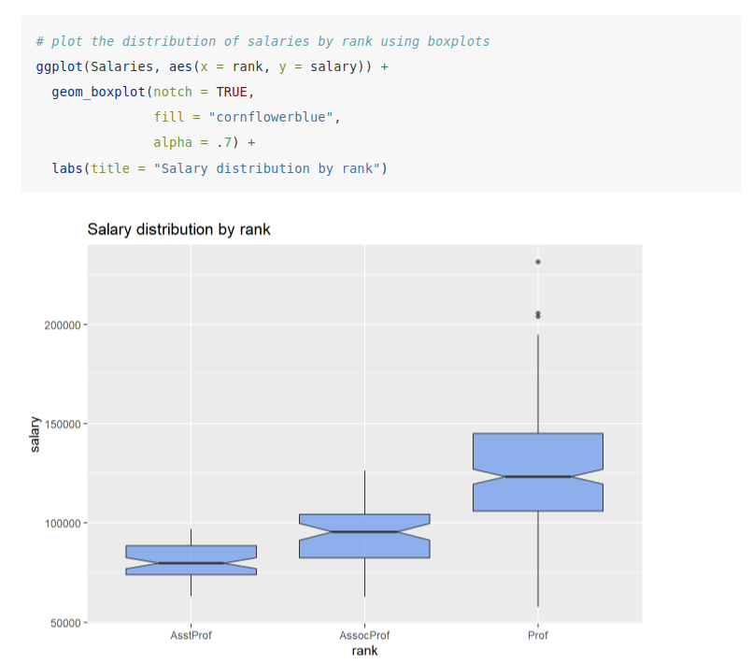
Bivariate Graphs
Categorical vs. Quantitative

